Slide 1
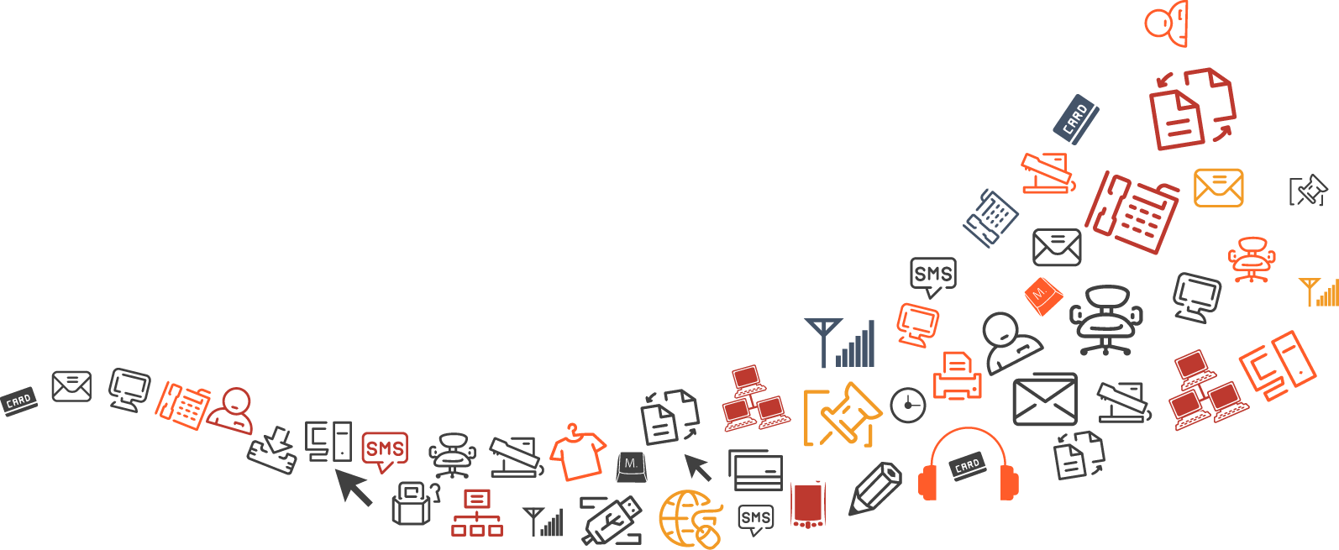
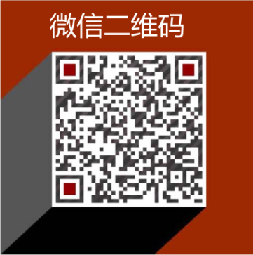
SEO- 搜索引擎优化
常用英语术语中文解析
www.seotalent.tech

Slide 2
On Page optimization
目录
Off Page optimization
CONTENTS
Important Terms to Remember
SEO Formulas

Slide 3
SEO优化面向的读者
SEO优化常用英语术语中文解析面向的读者
SEO专员和相关工作者
个人网站爱好者或计划开网店生意业主，
社会化媒体推广人员，
网站程序员要拓展SEO搜索引擎优化知识
大学毕业生想要多学习一门职业技能
博客写手
使用过SEO服务公司的企业想要自己掌握SEO技术，
产品销售市场营销人员要掌握有效电子销售技巧的个人或团队，
国际贸易或国际市场推广人员

Slide 4
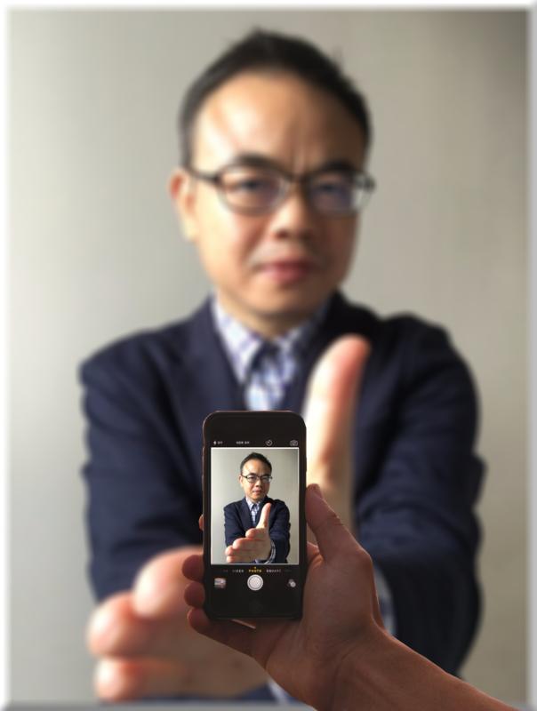
盛老师简介
曾担任过上海外国语大学国际教育中心英语讲师
WORDPRESS网站程序员
SEO搜索引擎优化专员
擅长于网页设计
前端UX用户体验设计
中英文网站编辑
外贸SEO搜索引擎优化
个人IT博客网站
www.seotalent.tech

Slide 5
Unit 1. On-Page SEO
SEO (Search Engine Optimization) is the process of maximizing a website’s ‘organic’ (non-paid) visits and sales from search engines.
搜索引擎优化
天然的，有机的

Slide 6
Unit 1. On-Page SEO
On Page optimization (on-page SEO) is what can be done on the pages of a website to maximize its performance in the search engines for target keywords related to the on-page content.
网站页面优化

Slide 7
Unit 1. On Page SEO
Off Page optimization (off-page SEO) is mainly about getting links from other websites to your website.
网站页面之外的优化

Slide 8
Unit 1. On Page SEO
SEO PRACTICES:
1. White Hat SEO – ethical SEO methods 白帽
2. Black Hat SEO – SEO methods that do not follow the search engine guidelines 黑帽
3. Grey Hat SEO 灰帽

Slide 9
Unit 1. On Page SEO
Header Tags / H-Tags
There are six sizes of heading tags, beginning with <h1>, the most important, and ending with <h6>, the least important (1).These tags do not carry much weight when it comes to SEO but it helps in content readability for users.
段落标签

Slide 10
Unit 1. On Page SEO
URL Structure =Uniform Resource Locator 网页地址
An optimal URL structure will not use numbers or strange characters on the permalinks, it will be short and describe the content of the page.

Slide 11
Unit 1. On Page SEO
Hover 悬浮
Navigation Bar导航栏
Main Menu 主要菜单
Sub Menu 子菜单

Slide 12
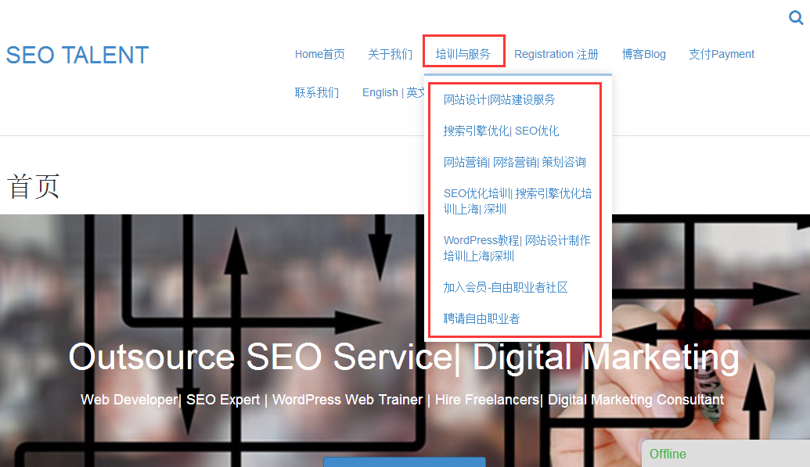
单击输入标题内容

Slide 13
Unit 1. On Page SEO
The visible, clickable text in a hyperlink
超链接

Slide 14
Unit 1. On Page SEO
site map (lowercase)
Contains an organized listing of links to all pages within the website. Visitors may visit this page if they are having problems finding pages on your site
网站地图

Slide 15
Unit 1. On Page SEO
HTML sitemap
An XML Sitemap, which you can submit through Google's Webmaster Tools, makes it easier for Google to discover the pages on your site.
HTML网站地图

Slide 16
Unit 1. On Page SEO
1. Title tags—one of the most important on-page SEO factors as they tell the search engines and the internet users what the webpage is about.
o Title tags are unique for every page.
o Keywords are used in the title tags.
o The title tags are at 60 characters or less in length (including spaces).
主题标签

Slide 17
Unit 1. On Page SEO
2. Meta Descriptions—while not as significant as title tags in SE rankings, they are very vital in getting internet users to click through from the SERP to your website.
o Unique meta description for each page
o No quotation marks as Google cuts quotes out of the meta descriptions. To be on the safe side, it is better to avoid using non-alpha characters such as !$%^&*() in your meta description.
o The description is 150-160 characters including spaces
基本描述

Slide 18
Unit 1. On Page SEO
3. Content—is the “meat” of your website. Since the rolling out of the Google Panda in 2011, it is extremely important that the content of your website is unique and relevant. Websites that have multiple pages containing the same content or web pages that have copied content from other websites will run the risk of getting penalized by Google. Getting penalized by Google doesn’t mean lawsuits and paying fines. No, Google can do worse than that—it can remove you from its index which will eventually result to your website’s traffic (internet users coming to and from your website) and sales dropping precipitously. 内容

Slide 19
Unit 1. On Page SEO
o The keyword density in the body text is 20% (total number of keywords / total number of words)
o Individual keyword density is 6% (number of individual keyword / total number of words)
o Unique content from every medium such as press releases, social media updates, etc.
关键词密度

Slide 20
Unit 1. On Page SEO
4. Header tags and Keyword Phrases—are also important in SEO. A header tag is also known in SEO as an <hn>, in which n is a number between 1-6.
o Use your keyword phrase once in your H1 tag
o Use H1 tags on pages you are trying to drive unique traffic to (SEO page)
o Use H2 tags if there are multiple sections
段落标签与关键词组

Slide 21
Unit 1. On Page SEO
5. Internal Page Linking with Anchor Text --refers to a link on a page that points to another page within the same website.
o When linking to another page on the same site from within content, select good anchor text (keywords) to use in the actual link and do this often. For example: “We offer a wide range of web design services,” rather than “Click here for our services.”
网站内部锚文本链接

Slide 22
Unit 1. On Page SEO
6. Image ALT Tags and Filenames—An alt tag is essentially the name of an image. All images should use appropriate alt tags. Not only are alt tags good for search engines; they are also good for accessibility. If someone is using a screen reader, they will be able to hear what that image is.
图片标签和文件名

Slide 23
Unit 1. On Page SEO
7. Make Content Easy to Read--This is not a huge factor in search engine rankings, but will help your users easily scan your content and find the keywords they are looking for. You should use bolding and bullet points to set apart words in the text, and this further tells the engines what is important on the page. Don’t go wild or you’ll end up cluttering up your page and aggravating the user.
网页容易阅读

Slide 24
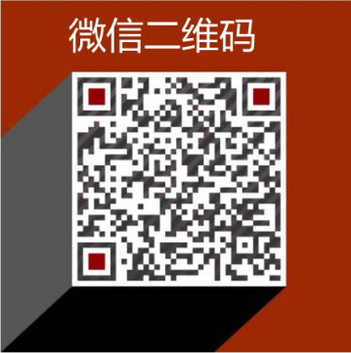
MANY THANKS TO YOU

